Slide 1
Simulation of Honeycomb Structures under Compression, Bending, and Torsion
Tianyi Wang, Erik Ren

Slide 2
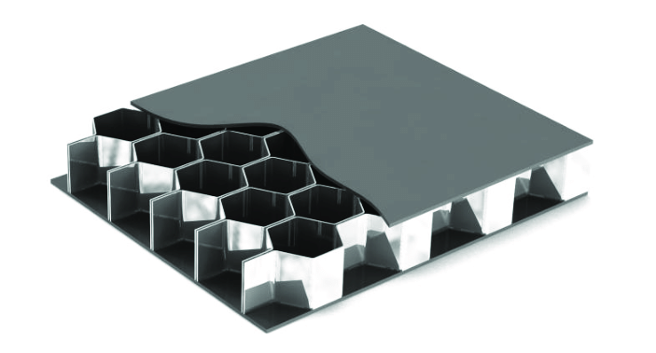
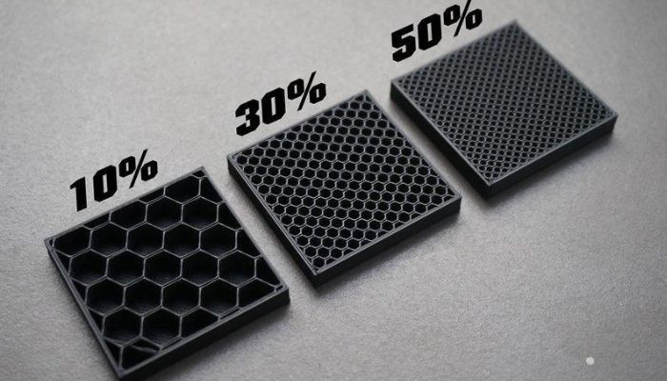
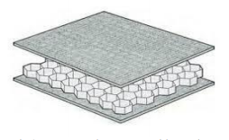
Why honeycomb structure?
Outstanding mechanical properties with reduced material usage
Widely adopted in numerous promising applications in the fields of:
Architecture
Aerospace
Medical implant
3d printing

Slide 3
Overview of Prior Works
computational and experimental analyses of honeycomb structures are investigated by many researchers in literature

Slide 4
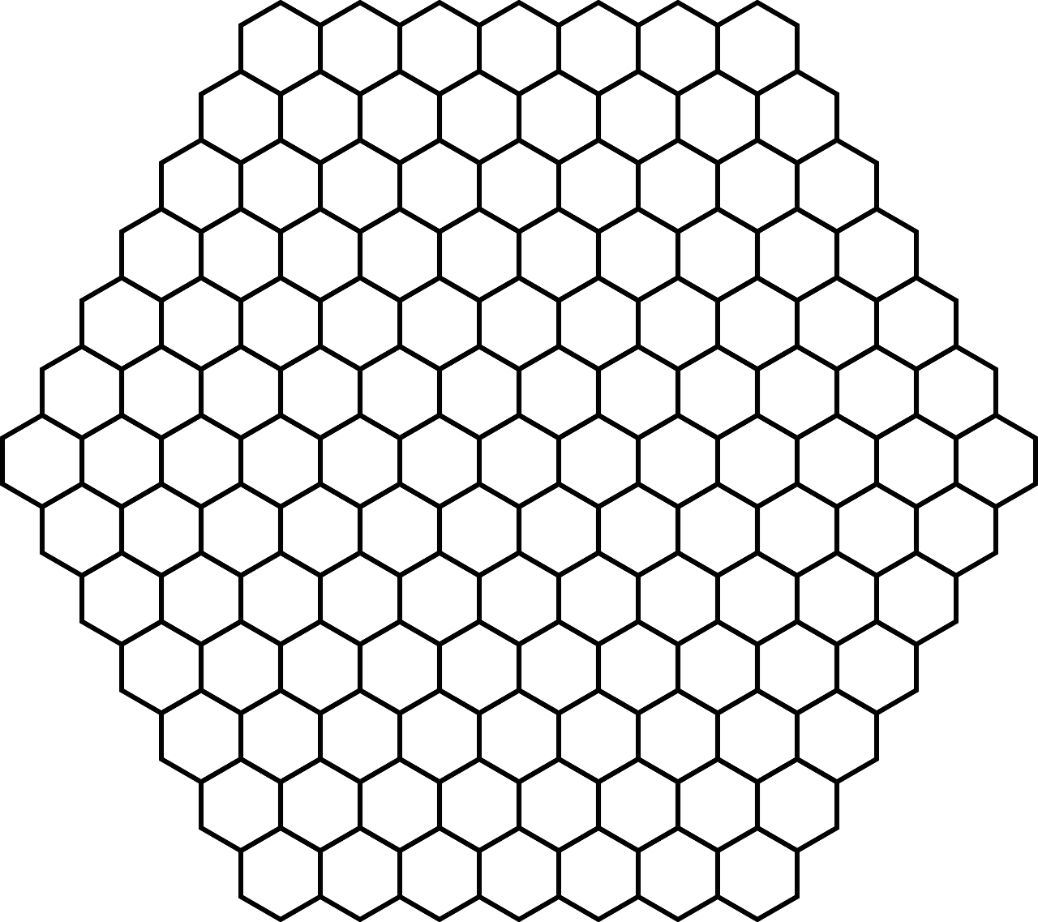
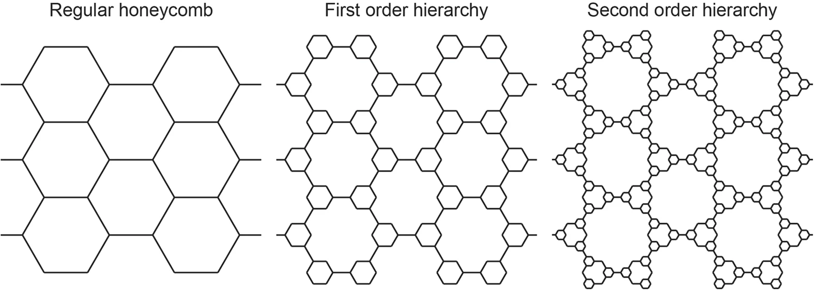
Simulation objective
Evaluate the mechanical behavior of honeycomb structures with varying cell counts and wall thicknesses
Explore improvement and optimization for hybrid structures
…...
?

Slide 5
Reference
Aminanda, Y., B. Castanié, J.J. Barrau, et al. "Experimental Analysis and Modeling of the Crushing of Honeycomb Cores." Applied Composite Materials, vol. 12, 2005, pp. 213–227.
Asprone, Domenico, et al. "Statistical Finite Element Analysis of the Buckling Behavior of Honeycomb Structures." Composite Structures, vol. 105, Nov. 2013, pp. 240–255.
Mousanezhad, D., S. Babaee, H. Ebrahimi, et al. "Hierarchical Honeycomb Auxetic Metamaterials." Scientific Reports, vol. 5, 2016, article 18306. Nature, https://doi.org/10.1038/srep18306.
Partovi Meran, Ahmad, et al. "Numerical and Experimental Study of Crashworthiness Parameters of Honeycomb Structures." Thin-Walled Structures, vol. 78, May 2014, pp. 87–94.
Papka, S.D., and S. Kyriakides. "Experiments and Full-Scale Numerical Simulations of In-Plane Crushing of a Honeycomb." Acta Materialia, vol. 46, no. 8, 1 May 1998, pp. 2765–2776.
Qi, Chang, et al. "Advanced Honeycomb Designs for Improving Mechanical Properties: A Review." Composites Part B: Engineering, vol. 227, 15 Dec. 2021, article 109393.
Yamashita, M., and M. Gotoh. "Impact Behavior of Honeycomb Structures with Various Cell Specifications—Numerical Simulation and Experiment." International Journal of Impact Engineering, vol. 32, nos. 1–4, Dec. 2005, pp. 618–630.

